Slide 1

Department of Information Technology
Intelligent Medical Image Analysis with
Automated Clinical Report Generation
NAME : | M.Hrushikesh | N.Vinesh | N.Ramana | B.Mallesh
Roll No: | 23BDB1A6636 | 23BD1A663B | 23BD1A6639 | 23BD1A6627
SECTION: | CSM-B | CSM-B | CSM-B | CSM-B

Slide 2
Intelligent Medical Image Analysis with
Automated Clinical Report Generation
Index:
    Abstract
    Introduction
    Literature Survey
    Existing System and Its Limitations
    Proposed Solution
    Proposed Methodology
    Implementation ( Algorithms and Screenshots)
    Conclusion
    Future Enhancement
    References

Slide 3
Abstract
Medical image analysis is increasingly adopting Vision-Language Foundation Models (VLMs) to jointly understand visual information and clinical knowledge. Inspired by recent advances in multimodal medical AI, this project presents an intelligent medical image analysis system capable of analyzing both visible-light medical images and radiological scans through a unified pipeline.
The proposed framework integrates modality-aware vision models, lesion localization, segmentation, severity estimation, Retrieval-Augmented Generation (RAG), and automated clinical report generation. The system further recommends the appropriate medical specialist and provides an AI-powered clinical assistant for follow-up medical queries. By combining foundation models with modern computer vision techniques, the proposed solution aims to improve diagnostic accuracy, explainability, and clinical decision support.

Slide 4
Introduction
Recent advances in Vision-Language Models have transformed medical image analysis by enabling joint understanding of medical images and textual clinical knowledge. Unlike conventional deep learning models that perform isolated classification tasks, modern medical VLMs support disease diagnosis, localization, report generation, visual question answering, and clinical reasoning within a unified framework.
Inspired by these developments, this project proposes an intelligent multimodal medical diagnosis system capable of processing multiple imaging modalities through specialized foundation models. The framework automatically detects image modality, identifies diseases, localizes pathological regions, estimates severity, generates structured clinical reports, and provides retrieval-grounded medical explanations using RAG.

Slide 5
Literature Survey
Recent research demonstrates that Vision-Language Foundation Models such as BiomedCLIP, Med-PaLM M, BiomedGPT, RadFM, and MedVersa have significantly improved medical image understanding by learning joint representations of images and clinical text. These models support tasks including disease classification, report generation, image-text retrieval, visual question answering, segmentation, and multimodal reasoning.
The survey also highlights that Retrieval-Augmented Generation reduces hallucination in clinical report generation by grounding responses using retrieved medical knowledge. Furthermore, modern systems increasingly integrate object detection, segmentation, and specialist recommendation to provide comprehensive clinical decision support.

Slide 6
Existing System and Its Limitations
Current AI-based medical diagnosis systems are primarily designed for single imaging modalities such as Chest X-ray, MRI, CT, retinal images, or dermatology images. Most existing approaches perform only disease classification without providing complete clinical assistance.
Limitations:
Single-modality diagnosis
Limited localization capability
No lesion segmentation
No severity estimation
No retrieval-based medical knowledge
No structured clinical report generation
No interactive AI clinical assistant

Slide 7
Proposed Solution
The proposed system integrates Vision-Language Foundation Models with modern Computer Vision and Large Language Models to create an end-to-end intelligent medical diagnosis platform.
Features:
Automatic modality detection
Disease classification
Lesion localization
Lesion segmentation
Severity estimation
Specialist recommendation
Automated PDF clinical report generation
Retrieval-Augmented Generation (RAG)
AI Clinical Assistant

Slide 8
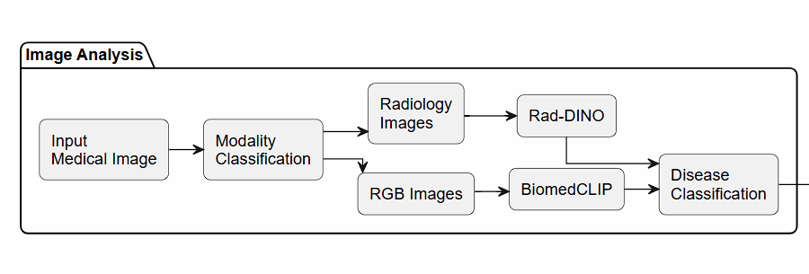
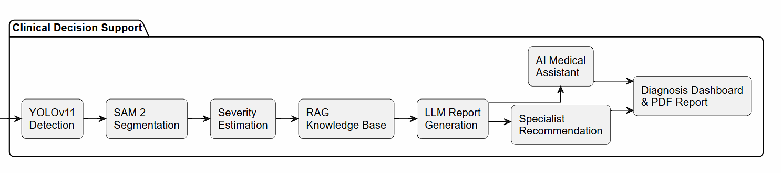
Proposed Methodology

Slide 9
Implementation
Module | Technology
Frontend | React.js
Backend | FastAPI
Database | MongoDB
AI Framework | PyTorch
RGB Vision Model | BiomedCLIP
Radiology Vision Model | Rad-DINO
Detection | YOLOv11
Segmentation | SAM 2
Knowledge Retrieval | RAG
Report Generation | Large Language Model
PDF Generation | ReportLab

Slide 10
Implementation - 1: (Algorithms)
Algorithm 1: Modality Classification
Purpose
Identify whether the uploaded medical image is a visible-light image or a radiological scan.
Algorithm
Accept uploaded image.
Extract visual features.
Classify image modality.
Route image to the appropriate foundation model.
Algorithm 2: Disease Classification
Input
Medical Image
Process
Extract image embeddings.
Compare with learned disease representations.
Predict disease class.
Generate confidence score.
Algorithm 3: Lesion Localization & Segmentation
Input
Medical Image
↓
YOLOv11 Detection
↓
SAM 2 Segmentation
↓
Localized Disease Region
Algorithm 4: Clinical Report Generation
Collect
Disease prediction
Localization result
Severity estimation
Retrieved medical knowledge
↓
Large Language Model
↓
Structured Clinical Report (PDF)

Slide 11
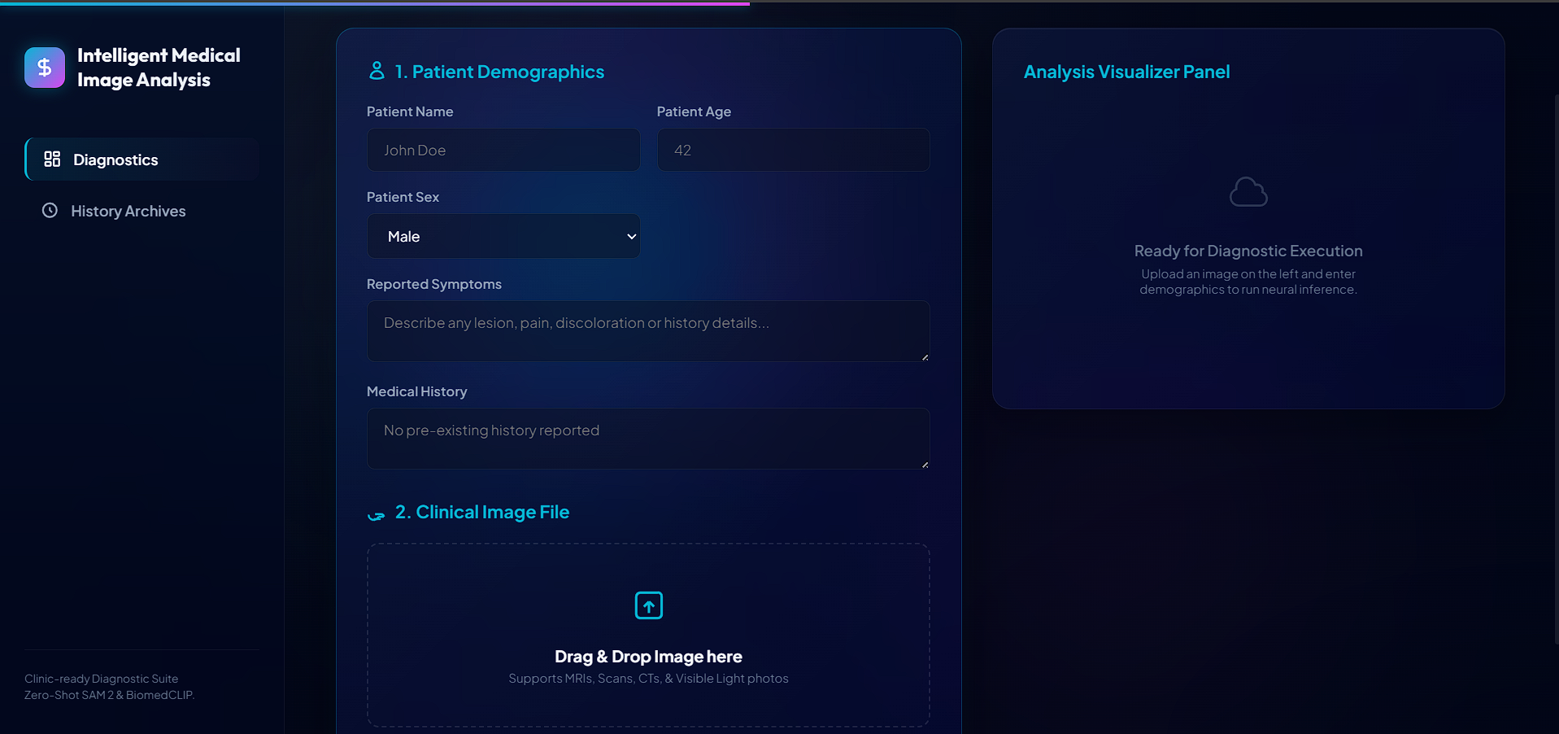
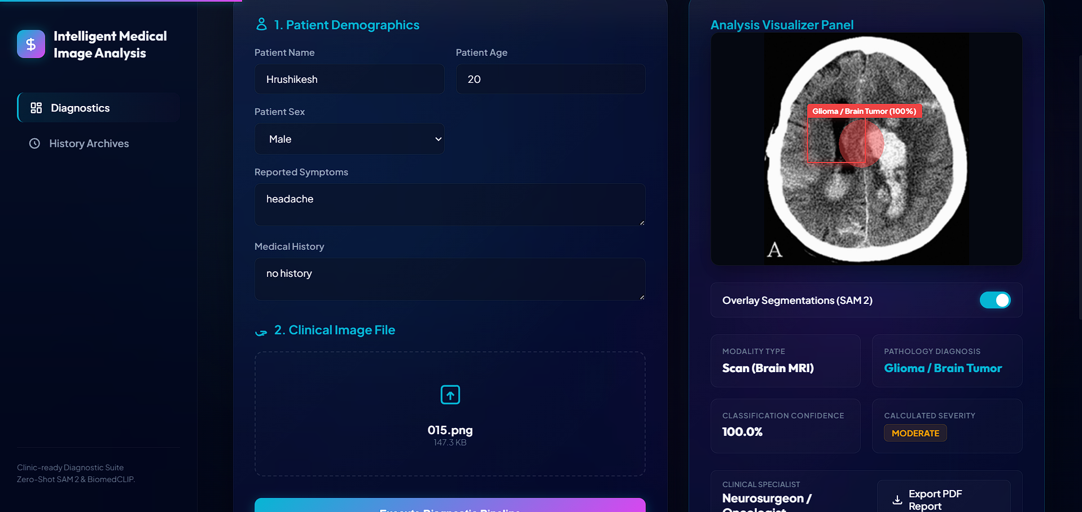
Implementation - 2: (ScreenShots)

Slide 12
Conclusion
This project presents an intelligent multimodal medical image analysis platform inspired by recent advances in Vision-Language Foundation Models. The proposed framework combines disease classification, lesion localization, segmentation, severity estimation, Retrieval-Augmented Generation, and automated clinical report generation within a unified pipeline.
By integrating foundation models with modern computer vision and language models, the system provides comprehensive clinical decision support while improving diagnostic efficiency, explainability, and accessibility. The architecture also serves as a scalable foundation for future hospital-grade AI diagnostic systems.

Slide 13
Future Enhancement
Support additional imaging modalities
Fine-tune medical Vision-Language Models
Multi-image temporal reasoning
Electronic Health Record integration
Federated learning across hospitals
Explainable AI visualization
Real-time hospital deployment
Continuous learning using clinician feedback

Slide 14
References
Dasgupt, S., et al. Vision-Language Models in Medical Applications: A Review. IEEE Access, Vol. 14, 2026.
Zhang, Y., et al. BiomedCLIP: A Multimodal Biomedical Foundation Model Pretrained from Fifteen Million Scientific Image-Text Pairs. NeurIPS, 2023.
Kirillov, A., et al. Segment Anything. Proceedings of the IEEE/CVF International Conference on Computer Vision (ICCV), 2023.
Jocher, G., et al. YOLO: Real-Time Object Detection. Ultralytics Documentation.
Lewis, P., et al. Retrieval-Augmented Generation for Knowledge-Intensive NLP Tasks. NeurIPS, 2020.
Radford, A., et al. Learning Transferable Visual Models from Natural Language Supervision (CLIP). ICML, 2021.
Oquab, M., et al. DINOv2: Learning Robust Visual Features without Supervision. 2023.

Slide 15
THANK YOU!

Slide 16
Any Queries?

